Slide 1
HISTOGRAM PROCESSING (DIGITAL IMAGE PROCESSING)
Faculty of Information Technology Ton Duc Thang University
August 2023

Slide 2
Image Enhancement
Brightness and contrast
Histogram Equalization
Image histogram
Histogram equalization techniques
Adaptive histogram equalization
Applications
Image filtering
Convolution
Noise removal
Python
OpenCV

Slide 3
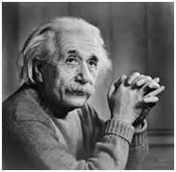
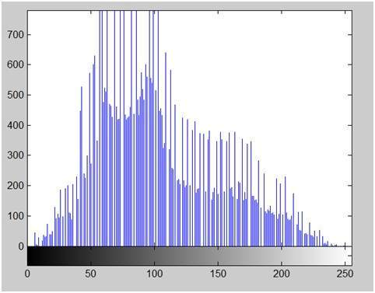
Histogram
Histograms shows frequency.
An image histogram, shows frequency of pixels intensity values.
In an image histogram, the x-axis shows the gray level intensities and the y-axis shows the frequency of these intensities.
The histogram of the above picture of the Einstein would be something like this

Slide 4
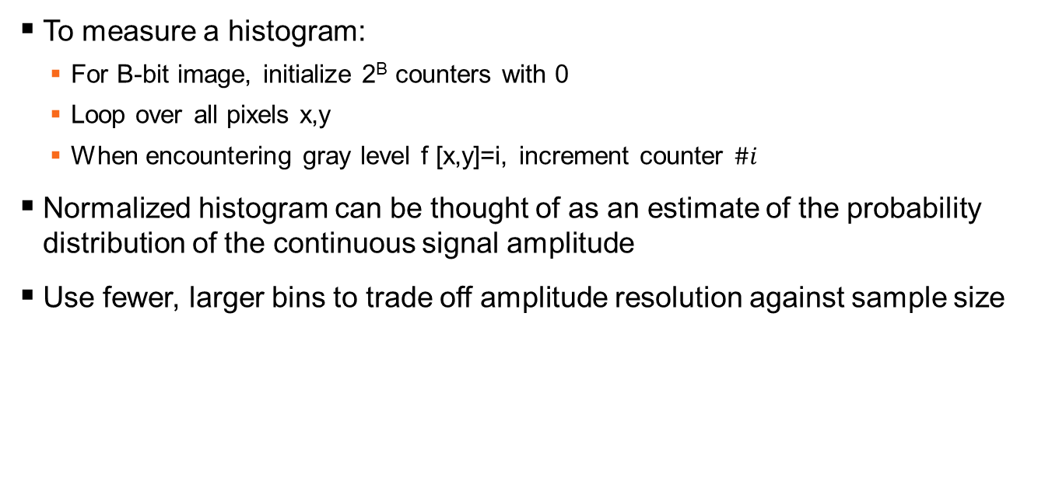
Gray level histograms

Slide 5
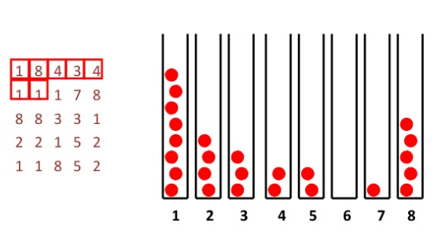
Histogram calculation

Slide 6
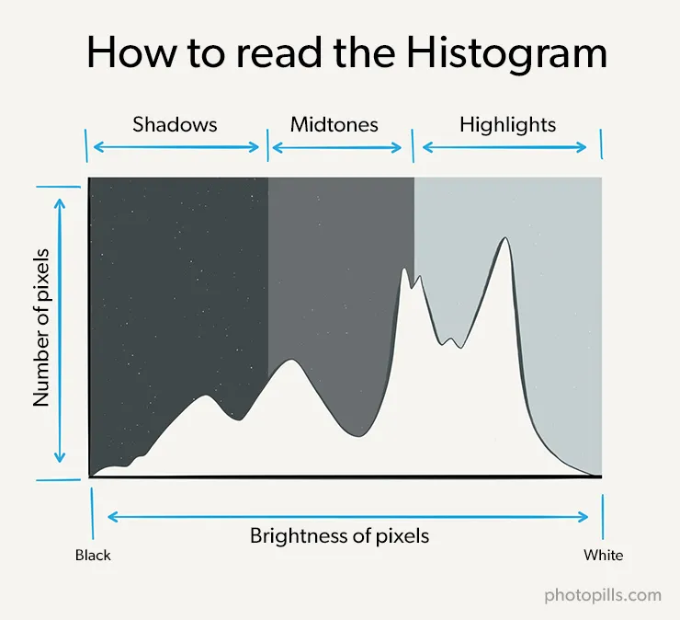

Slide 7
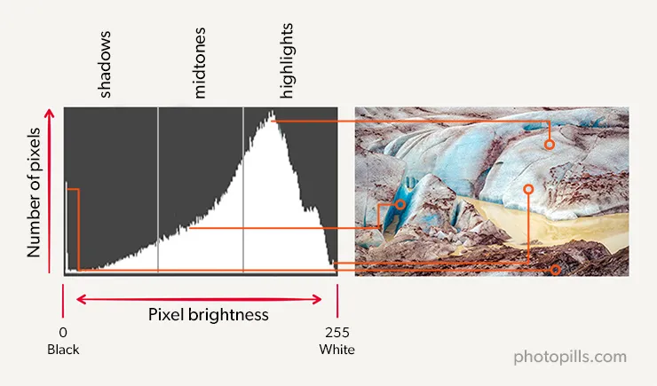
How to read the histogram
Along the horizontal axis (x) and from left to right you have:
First the black tones, with pure black on the left edge.
Then come the shadows.
Then the midtones.
Followed by the highlights.
And finally, the white tones, with pure white on the right edge.

Slide 8
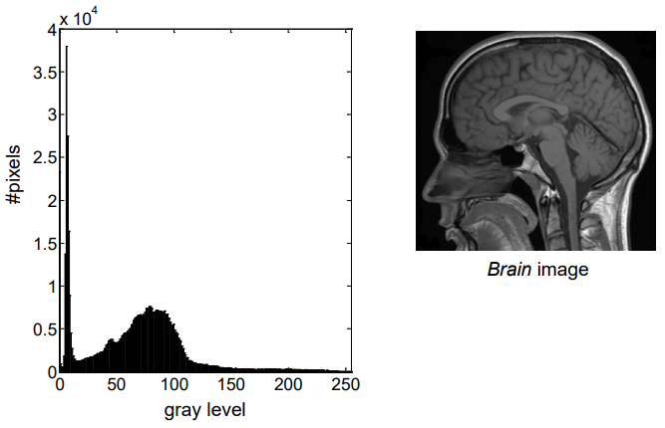
Gray level histograms

Slide 9
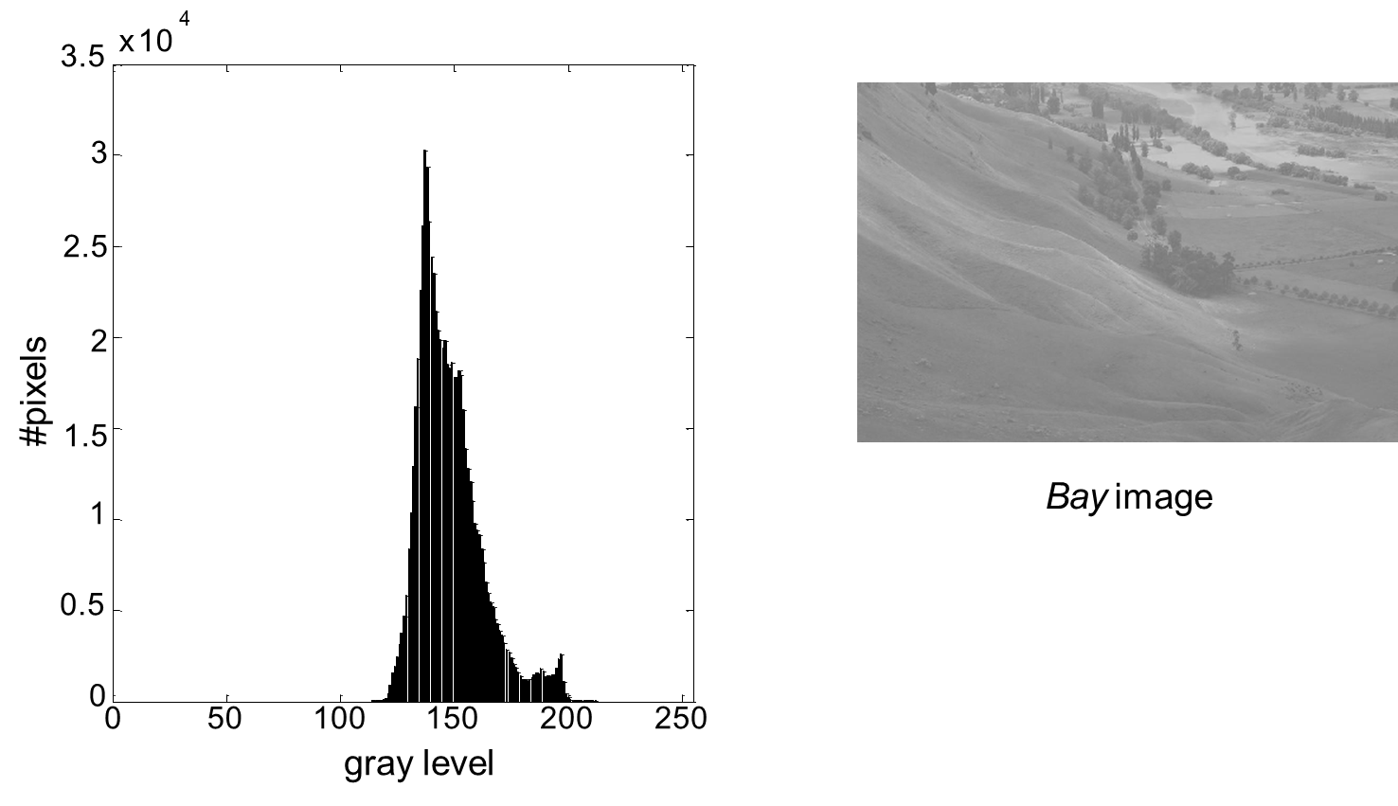
Gray level histograms

Slide 10
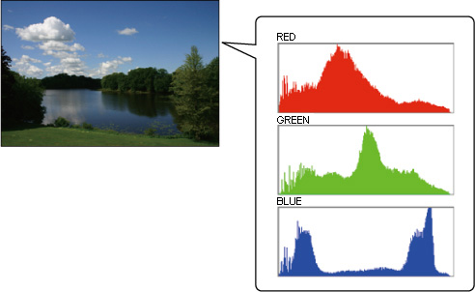
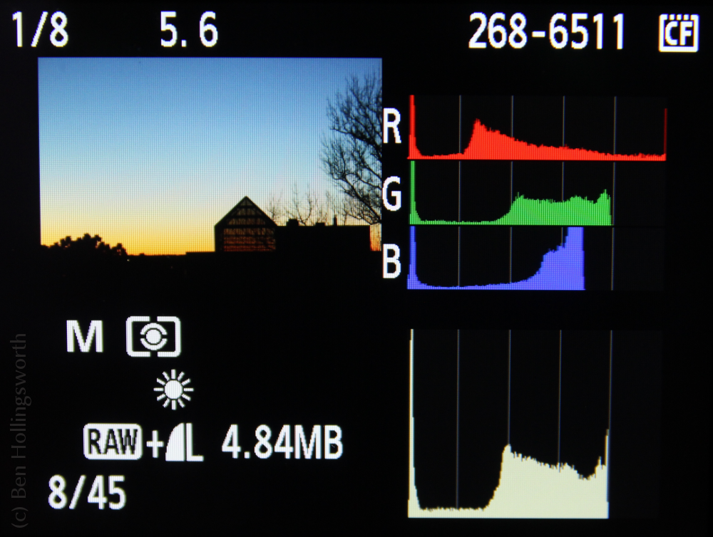
Histogram
Applications of Histograms:
We can predict about an image by just looking at its histogram. Its like looking an x ray of a bone of a body.
For brightness purposes.
To equalize an image used in adjusting contrast of an image.
Histogram has wide use in thresholding an image.

Slide 11
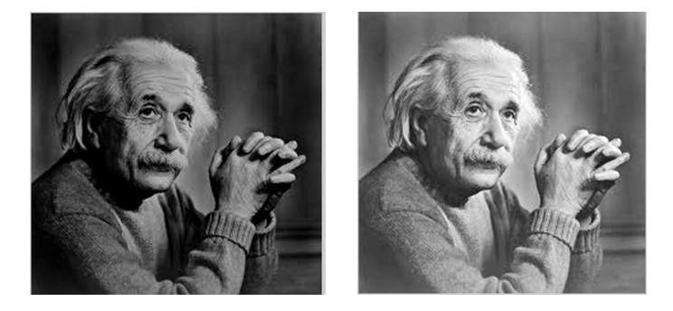
Which is brighter?

Slide 12
Brightness
Brightness can be defined as the amount of energy output by a source of light (Wiki)
Brightness is the perceived intensity of light coming from a source
Brightness is a relative term. It depends on your visual perception.

Slide 13
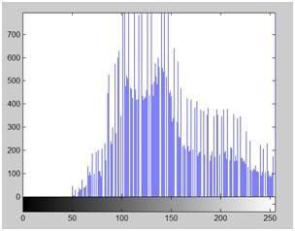
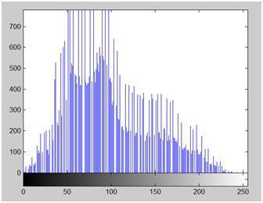

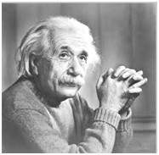
Brightness enhancement
+ 50
Sliding histogram

Slide 14
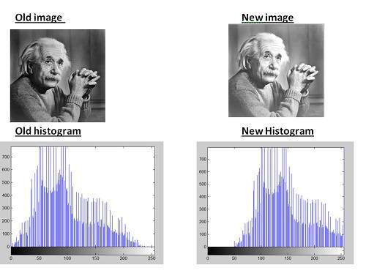
+ 50

Slide 15
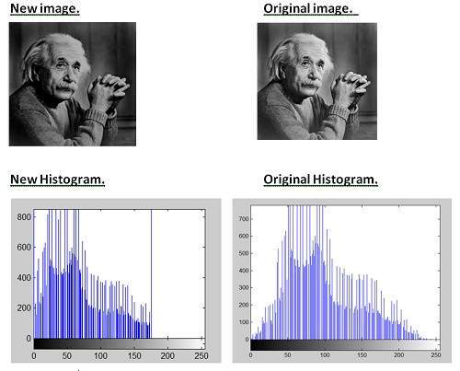
- 80

Slide 16
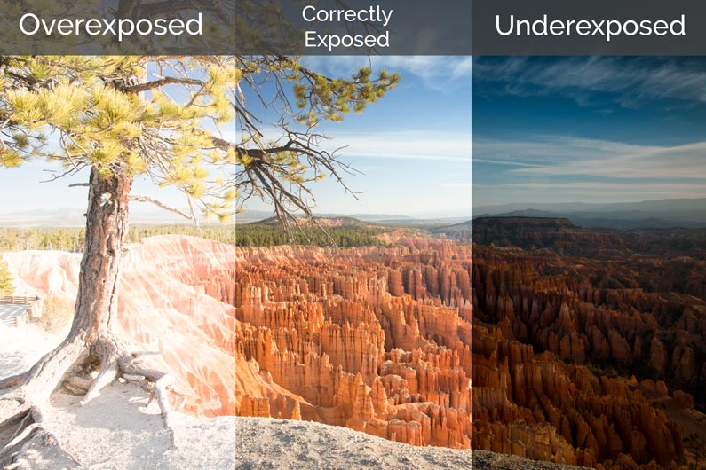
Brightness enhancement
Exposure problem
Over-exposed photo
Under-exposed photo
Flash
RAW image
HDR technology
High-dynamic-range photographs are generally achieved by capturing multiple standard-exposure images, often using exposure bracketing, and then later merging them into a single HDR image, usually within a photo manipulation program.

Slide 17
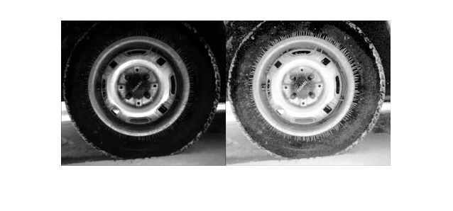
Contrast
the difference between maximum and minimum pixel intensity in an image.

Slide 18
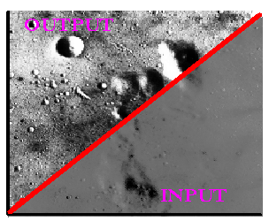
Contrast enhancement

Slide 19

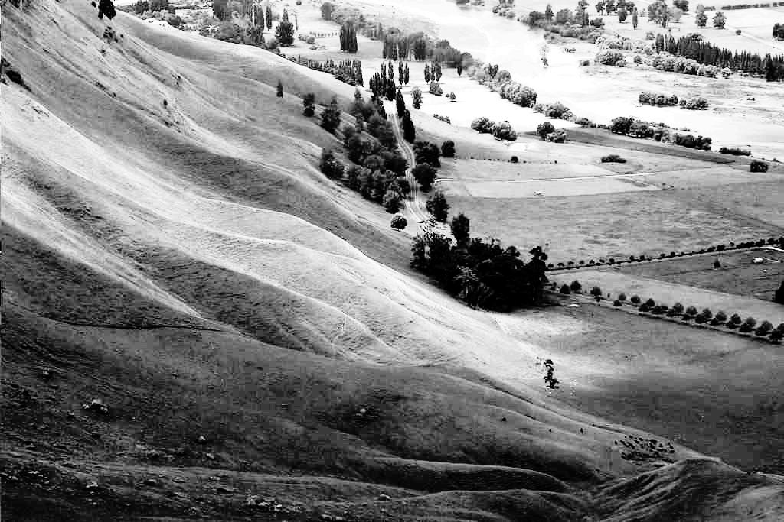
Histogram equalization example
Original image Bay
... after histogram equalization

Slide 20
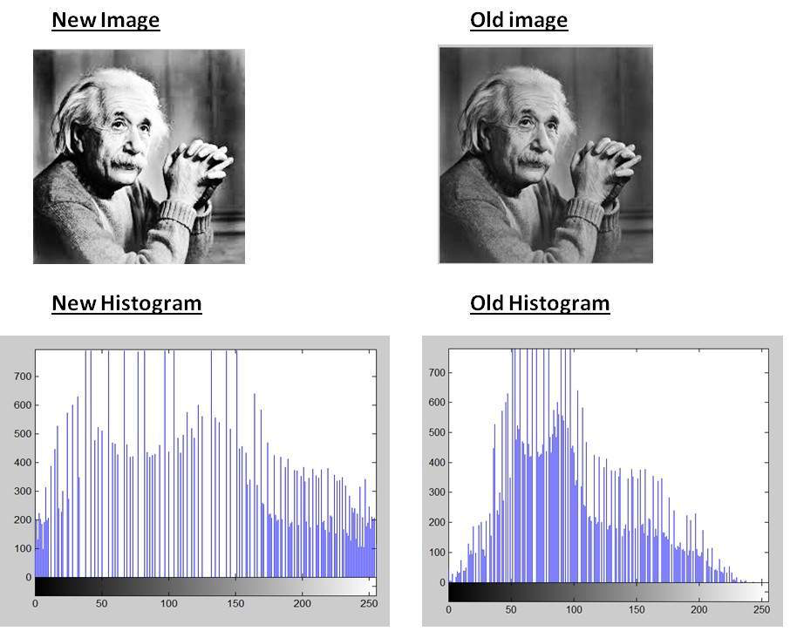

Slide 21
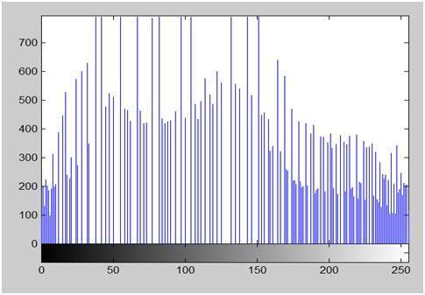
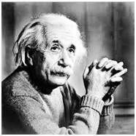

Slide 22
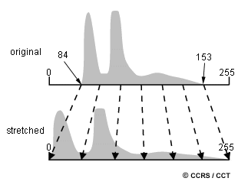
Contrast enhancement
Histogram Stretching
Increasing the contrast of an image

Slide 23
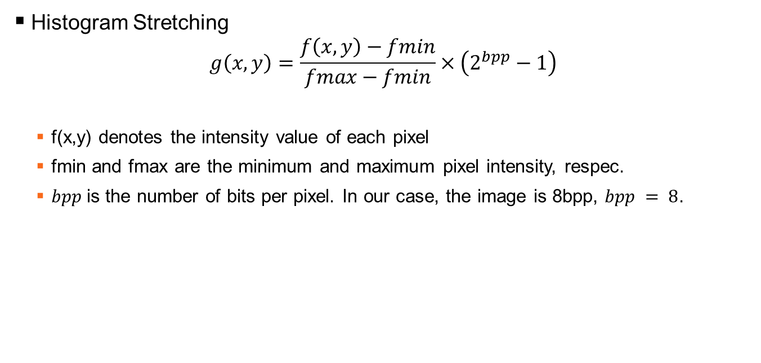
Contrast enhancement

Slide 24
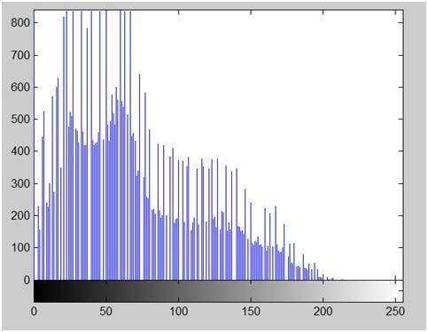
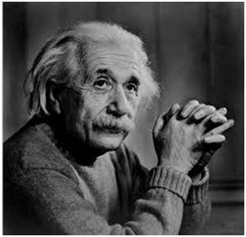
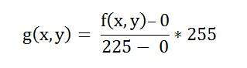
Contrast enhancement
Histogram Stretching - example
The minimum value is 0 and the maximum value is 225. So the formula in our case is
Contrast = 225

Slide 25
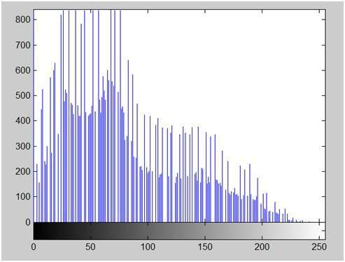

Contrast enhancement
Histogram Stretching - example
Contrast = 255

Slide 26
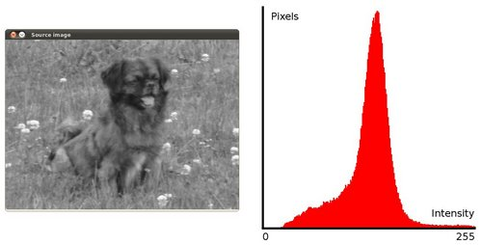
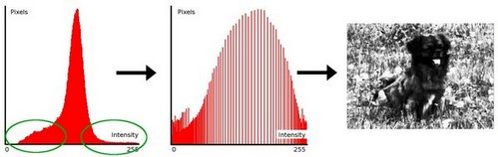
Contrast enhancement
Histogram Equalization
a technique to adjust contrast levels and expand the intensity range in a digital image.
Thus, it enhances the image which makes information extraction and further image processing easier.

Slide 27
Histogram equalization example
Original image Bay
... after histogram equalization

Slide 28
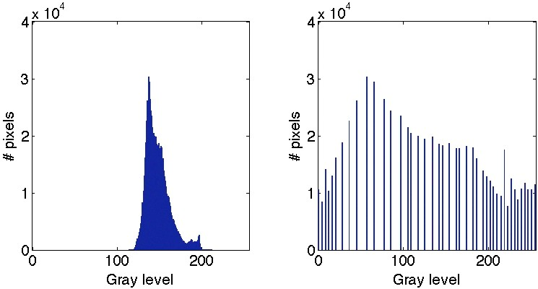
Histogram equalization example

Slide 29
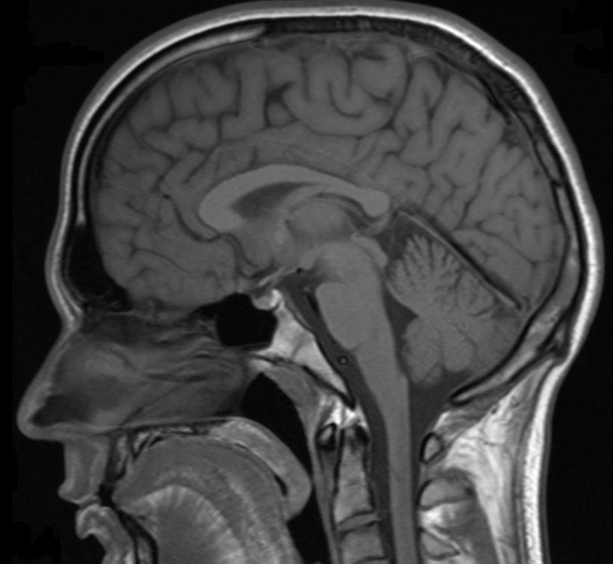
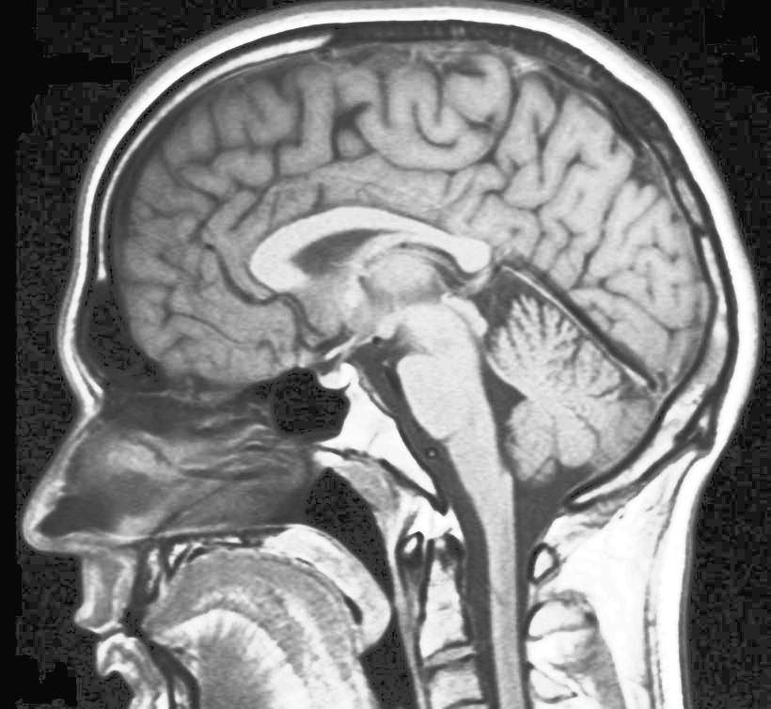
Histogram equalization example
Original image Brain
... after histogram equalization

Slide 30
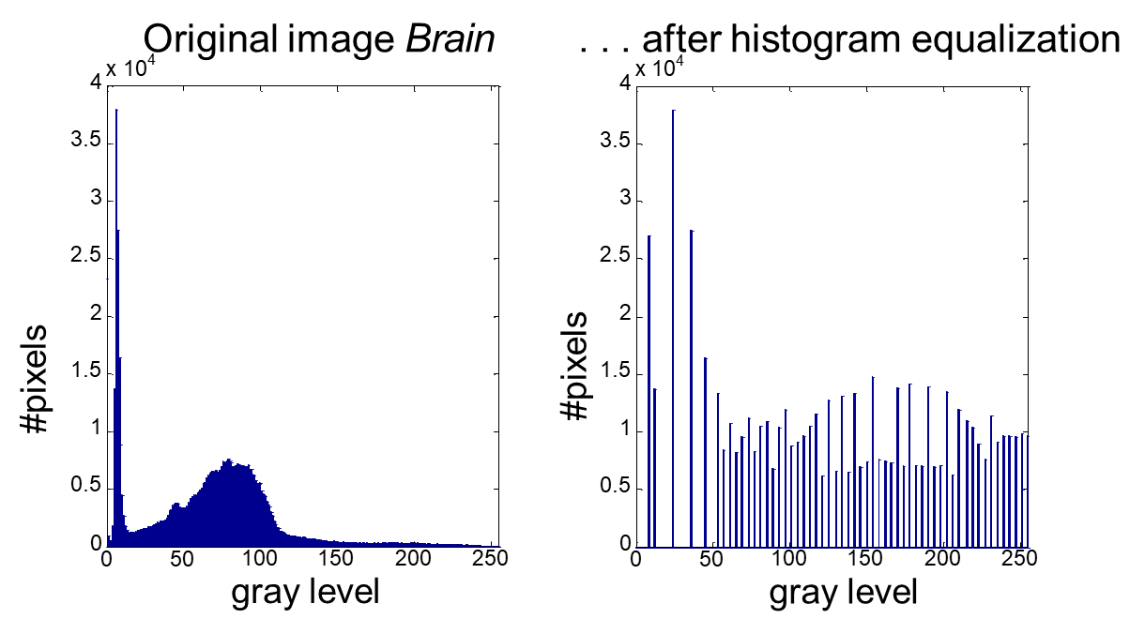
Histogram equalization example

Slide 31
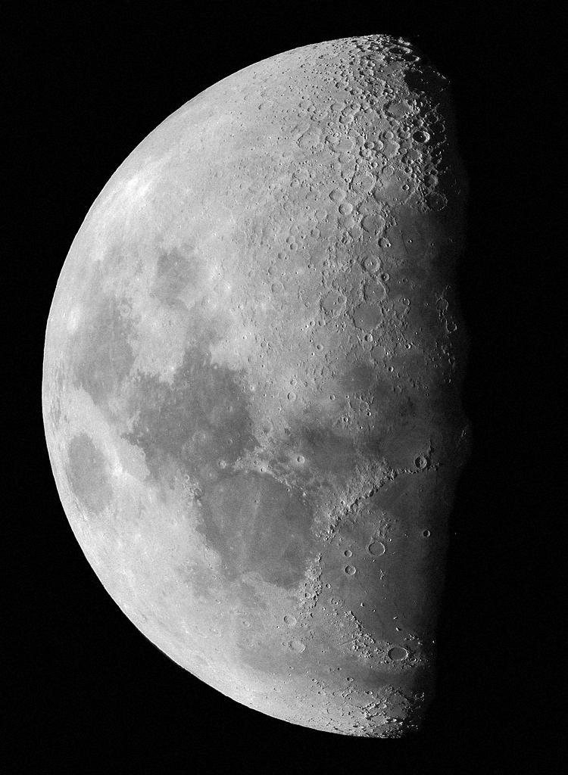
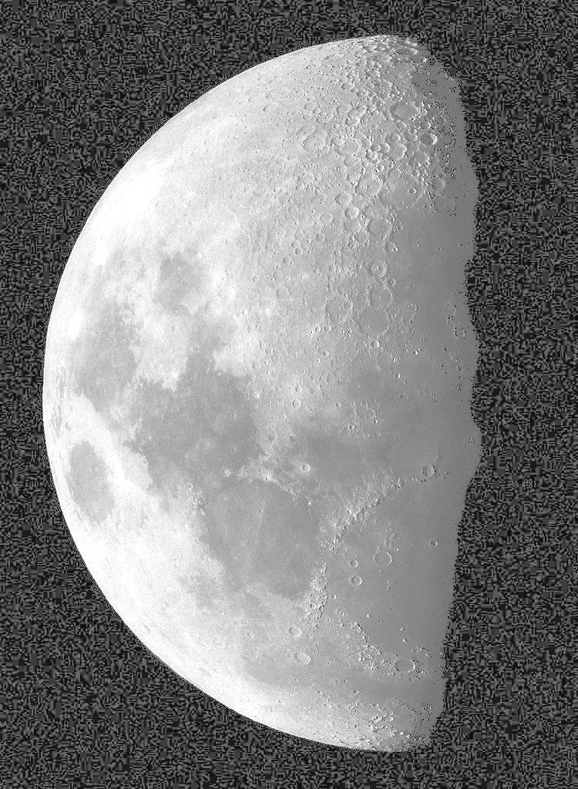
Histogram equalization example
Original image Moon
... after histogram equalization

Slide 32
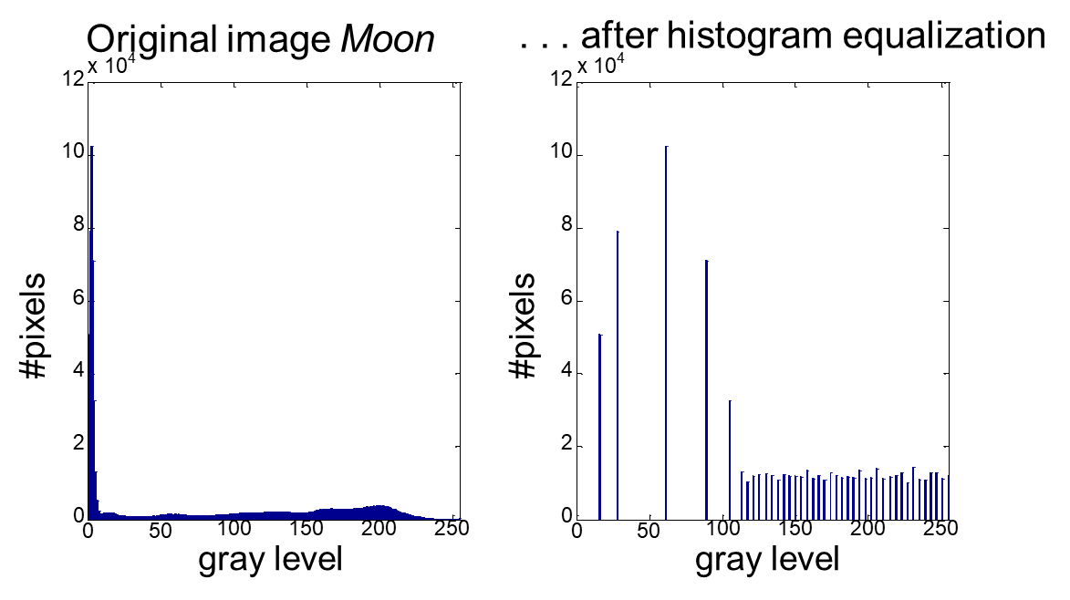
Histogram equalization example

Slide 33
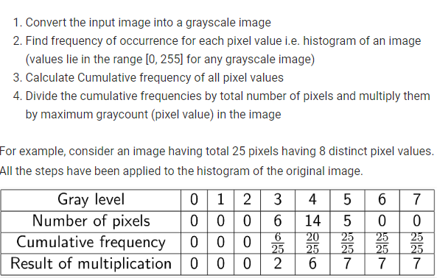
Histogram Equalization - An algorithm

Slide 34
PMF – Probability mass function CDF = Cumulative density function
Gray Level Value | CDF | CDF * (Levels-1) = CDF*7
0 | 0.11 | 0
1 | 0.22 | 1
2 | 0.55 | 3
3 | 0.66 | 4
4 | 0.77 | 5
5 | 0.88 | 6
6 | 0.99 | 6
7 | 1 | 7
1 | 2 | 7 | 5 | 6
7 | 2 | 3 | 4 | 5
0 | 1 | 5 | 7 | 3
1 | 2 | 5 | 6 | 7
6 | 1 | 0 | 3 | 4
Pixel | Count | PMF
0 | 2 | 2/25
1 | 4 | 4/25
2 | 3 | 3/25
3 | 3 | 3/25
4 | 2 | 2/25
5 | 4 | 4/25
6 | 3 | 3/25
7 | 4 | 4/25
Image pixel values
PMF
CDF

Slide 35
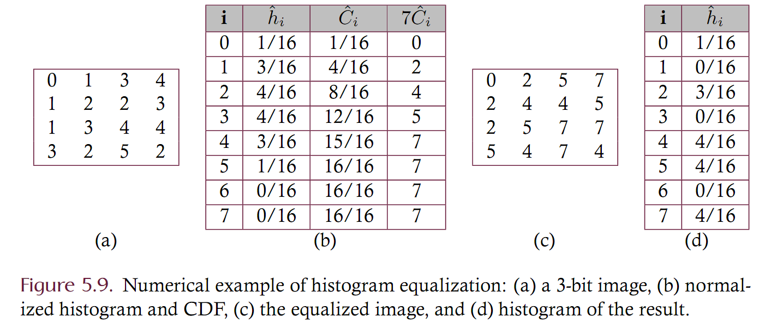
EXAMPLE

Slide 36
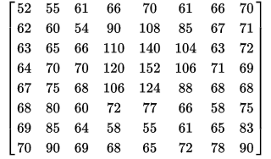
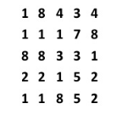
Example
8 Bit?
N Bit?

Slide 37
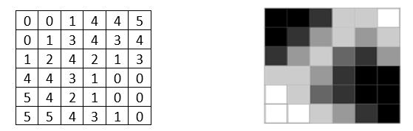
Histogram Equalization Ex. 1
- Write a pseudo code to equalize histogram of a grayscale image.
- Manually do histogram equalization for the following image:
3-bit image

Slide 38
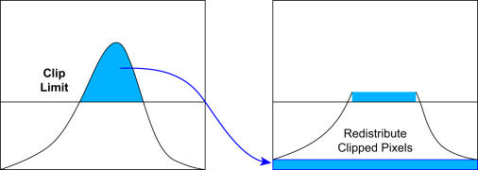
Contrast-limited histogram equalization
If any histogram bin is above the specified contrast limit, those pixels are clipped and distributed uniformly to other bins before computing the cumulative distribution function
limit the overamplification of noise
https://www.sciencedirect.com/topics/computer-science/histogram-equalization
https://docs.opencv.org/4.x/d5/daf/tutorial_py_histogram_equalization.html

Slide 39
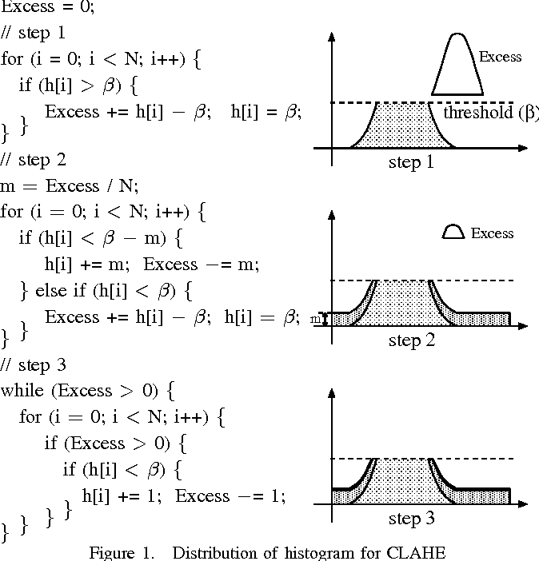
Contrast-limited histogram equalization
https://www.semanticscholar.org/paper/Real-Time-Processing-of-Contrast-Limited-Adaptive-Kokufuta-Maruyama/787ce60813fde958e6a3f21ad5072afc587c4241

Slide 40
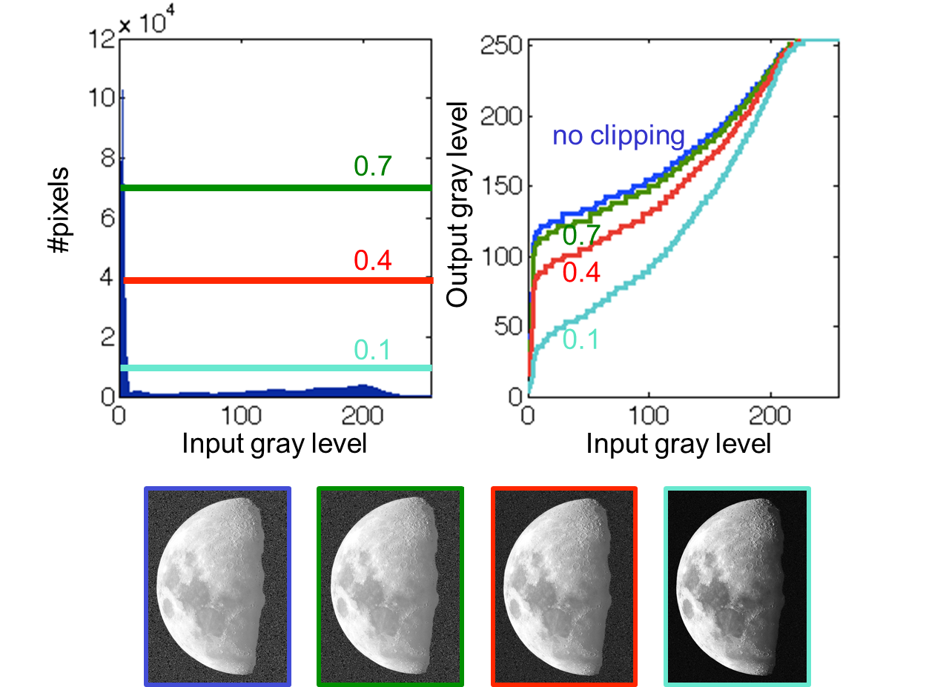
Contrast-limited histogram equalization

Slide 41
Contrast-limited Histogram Equalization Ex. 2
Given the specified contrast limit is 6.
Manually do contrast-limited histogram equalization for the following image:
3-bit image

Slide 42
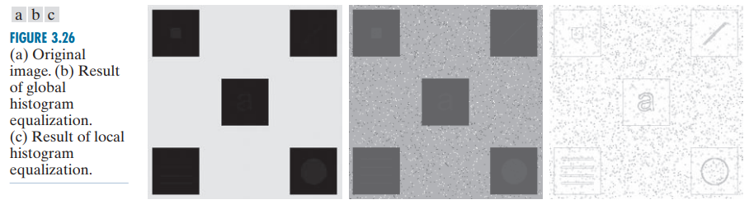
Adaptive (local) histogram equalization
The global approach is suitable for overall enhancement, but generally fails when the objective is to enhance details over small areas in an image.
Rafael C. Gonzalez, Richard E. Woods, [2018], Digital image processing, 4th edition, Pearson.

Slide 43
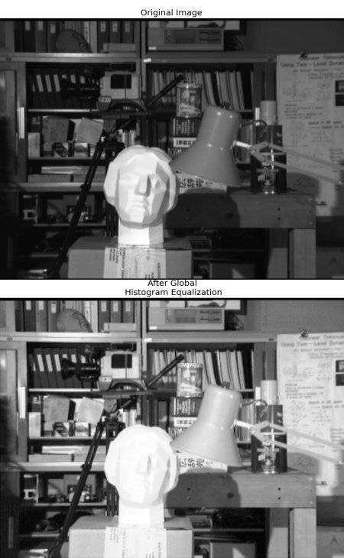
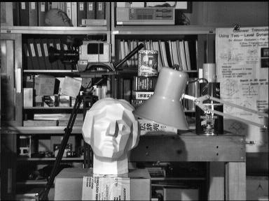
Adaptive (local) histogram equalization
Histogram is not confined to a particular region
After Local Histogram Equalization
https://docs.opencv.org/4.x/d5/daf/tutorial_py_histogram_equalization.html

Slide 44
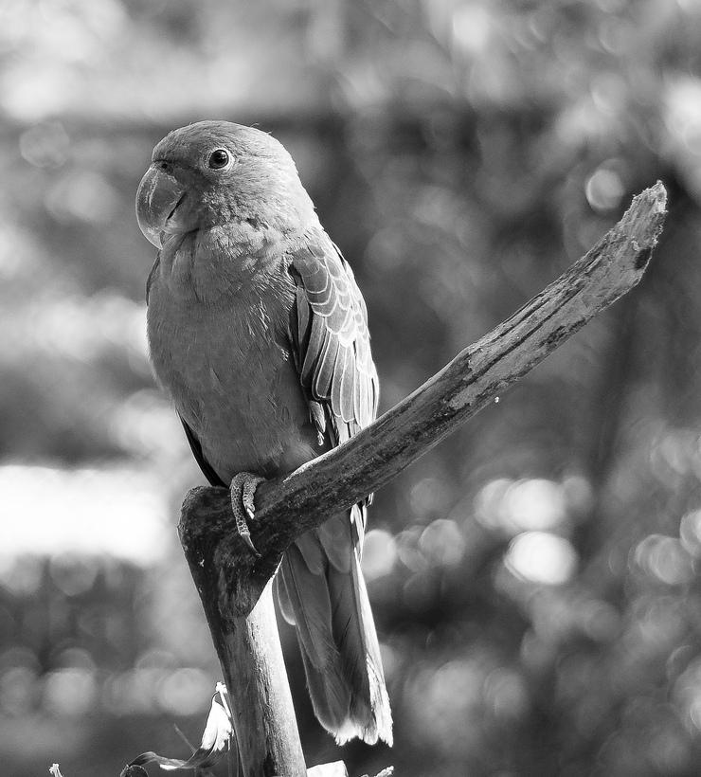
Adaptive histogram equalization
Histogram equalization based on a histogram obtained from a portion of the image
Limit contrast expansion in flat regions of the image, e.g., by clipping histogram values (“Contrast-limited adaptive histogram equalization”) [Pizer, Amburn et al. 1987]
Sliding window approach: different histogram (and mapping) for every pixel
Tiling approach: image is divided into small blocks called "tiles" (size is 8x8 in OpenCV). Then each of these blocks are histogram equalized as usual.

Slide 45
CLAHE (Contrast-Limited Adaptive Histogram Equalization)
Image is divided into small blocks called "tiles" (size is 8x8 in OpenCV)
Then each of these blocks are histogram equalized as usual.
In a tile, histogram would confine to a small region (unless there is noise). If noise is there, it will be amplified.
To avoid this, contrast limiting is applied. If any histogram bin is above the specified contrast limit (by default 40 in OpenCV), those pixels are clipped and distributed uniformly to other bins before applying histogram equalization.
After equalization, to remove artifacts in tile borders, bilinear interpolation is applied.

Slide 46

CLAHE
https://es.mathworks.com/

Slide 47



Adaptive histogram equalization
Original image
Parrot
Global histogram equalization
Adaptive histogram equalization, 8x8 tiles
Adaptive histogram equalization, 16x16 tiles

Slide 48




Adaptive histogram equalization
Original image
Dental Xray
Global histogram equalization
Adaptive histogram equalization, 8x8 tiles
Adaptive histogram equalization, 16x16 tiles

Slide 49




Adaptive histogram equalization
Original image
Skull Xray
Global histogram equalization
Adaptive histogram equalization, 8x8 tiles
Adaptive histogram equalization, 16x16 tiles

Slide 50
References
https://www.photopills.com/articles/exposure-photography-guide-2
https://web.stanford.edu/class/ee368/Handouts/Lectures/2014_Spring/Combined_Slides/4-Histograms-Combined.pdf
https://web.stanford.edu/class/ee368/Handouts/Lectures/2019_Winter/4-Histograms.pdf
https://www.tutorialspoint.com/dip/histogram_stretching.htm
https://slideplayer.com/slide/9293085/

Slide 51
References (ct)
https://web.stanford.edu/class/cs101/image-6-grayscale.html

